Slide 2
Neil P. Rodrigo, M.D., FPCAM, FPCOM
Fellow in OCCUPATIONAL MEDICINE
Fellow in ADDICTION MEDICINE
DOLE-BWC Certified OSH Professional
Certified OSH Trainer, DOLE-Occupational Safety and Health Center
National Trainer, Dangerous Drugs Board on UPC in Substance Use

Slide 3
SALIENT FEATURES of RA 11058

Slide 4
OSH LEGISLATION
P.D. 442, Book IV, Title I
Chapter I
Medical and Dental Services
Chapter II
Occupational Safety

Slide 5
OSH LEGISLATIONS
P.D. 442, Chapter II - Article 162
The Secretary of Labor shall by appropriate order set and enforce mandatory OSH Standards to eliminate or reduce OSH hazards in all workplaces and institute new and update existing programs to ensure safe and healthful working conditions in all places of employment
Notes:
Before promulgation of the Standards, OSH policies are in a form of safety orders.

Slide 6
OSH LEGISLATIONS
Article 165 – Administration and Enforcement
– DOLE shall be solely responsible for the administration, enforcement of laws, policies and programs on occupational safety and health. Chartered cities may be allowed to conduct technical safety inspection of establishments within their respective jurisdiction.
Notes:
Before promulgation of the Standards, OSH policies are in a form of safety orders.

Slide 7
OSH LAWS & ISSUANCES
Occupational Safety and Health Standards, (OSHS)1978
Book IV, Title I – Medical, Dental and Occupational Safety

Slide 8
Occupational Safety and Health Standards
A set of mandatory rules on OSH which codifies all safety orders issued prior to its promulgation
Patterned after the Standards of other developed countries

Slide 9
Rules of the Occupational Safety and Health Standards
1000 General Provisions
1010 Other Safety Rules
1020 Registration
1030 Training & Accreditation
1040 Health & Safety Committee
1050 Notification & Keeping of
Occupational Illnesses & Injuries
1060 Premises of Establishments
1070 Environmental Control
Personal Protective Equipment
1090 Hazardous Materials
1170 Unfired Pressure Vessels
1180 Internal Combustion Engine
Machine Guarding
1210 Electrical Safety
Elevators & Related Equipment
Identification of Piping System
Power Piping Lines
1410 Construction Safety
1420 Logging
Fire Protection & Control
1950 Pesticides & Fertilizers
1960 OH Services
1970 Fees
1980 Authority of LGUs
1990 Final Provisions
1100 Gas & Electric Welding &
Cutting Operations
1120 Hazardous Work Processes
1140 Explosives
1150 Materials Handling & Storage
1160 Boiler

Slide 10
REPUBLIC ACT 11058
AN ACT STRENGTHENING COMPLIANCE WITH OCCUPATIONAL SAFETY AND HEALTH STANDARDS AND PROVIDING PENALTIES FOR VIOLATIONS THEREOF

Slide 11
CHAPTERS OF RA 11058
CHAPTER I- DECLARATION OF POLICY
CHAPTER II- GENERAL PROVISIONS
CHAPTER III- DUTIES AND RIGHTS OF
EMPLOYERS, WORKERS AND OTHER PERSONS
CHAPTER IV- COVERED WORKPLACES
CHAPTER V- JOINT AND SOLIDARY LIABILITY
CHAPTER VI- ENFORCEMENT OF OCCUPATIONAL
SAFETY AND HEALTH STANDARDS
CHAPTER VII- MISCELLANEOUS PROVISIONS

Slide 12
CHAPTER I- DECLARATION OF POLICY
Section 1. Declaration of Policy.
-The State affirms labor as primary social and economic force, and that a safe and healthy workforce is an integral aspect of nation building.
-The State shall ensure a safe and healthful workplace for all working people by affording them full protection against all hazards in their work environment.

Slide 13
- It shall ensure that the provisions of the Labor Code of the Philippines, all domestic laws, and internationally-recognized standards on occupational safety and health are being fully enforced and complied with by the employers, and it shall provide penalties for any violation thereof.

Slide 14
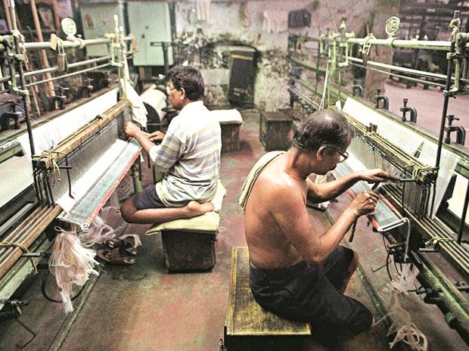
-The State shall protect every worker against injury, sickness or death through safe and healthful working conditions thereby assuring the conservation of valuable manpower resources and the prevention of loss or damage to lives and properties consistent with national development goals, and with State’s commitment to the total development of every worker as a complete human being

Slide 15
- The State in protecting the safety and health of the workers, shall promote strict but dynamic, inclusive and gender-sensitive measures in the formulation and implementation of policies and programs related to occupational safety and health.

Slide 16
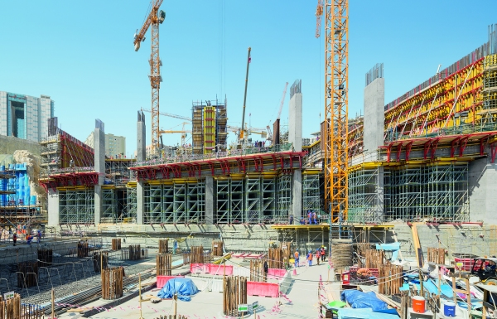
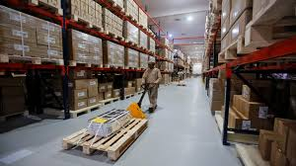
CHAPTER II- GENERAL PROVISIONS
Section 2. Coverage – Shall apply to ALL
- Establishments
- Projects
- Sites
- PEZA Establishments
- other places where work is undertaken
Except….PUBLIC SECTOR

Slide 17
Section 3. Definition of Terms –
There are 16 Terms that are defined in this Act.
In the IRR (DO 198-18) –
There are 29 Terms that are defined

Slide 18
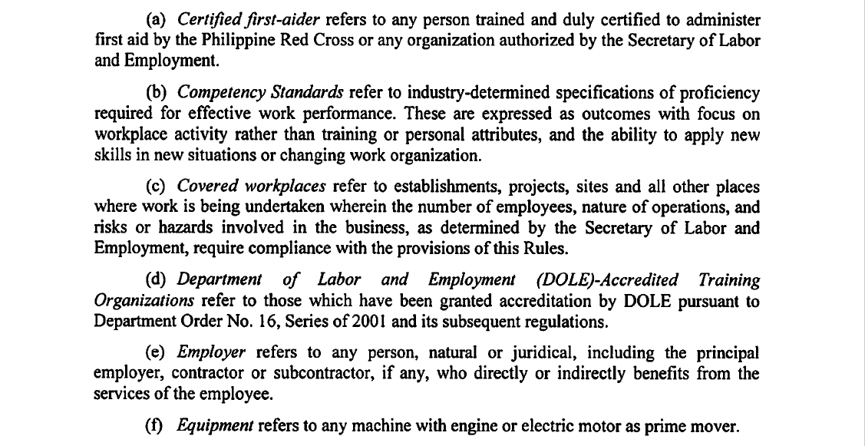
Terms in the IRR:

Slide 19
Terms in the IRR:

Slide 20
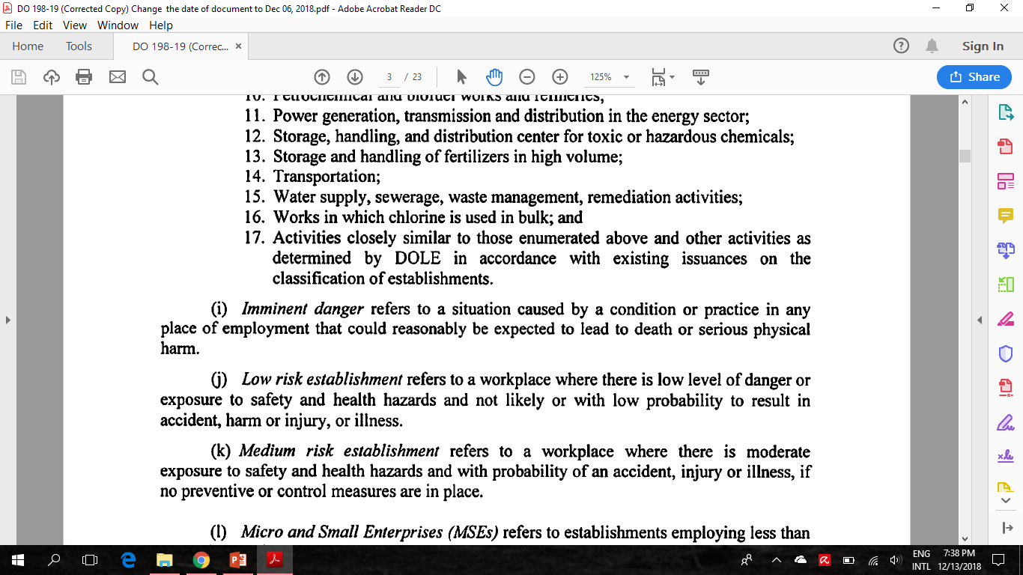
Terms in the IRR:

Slide 21
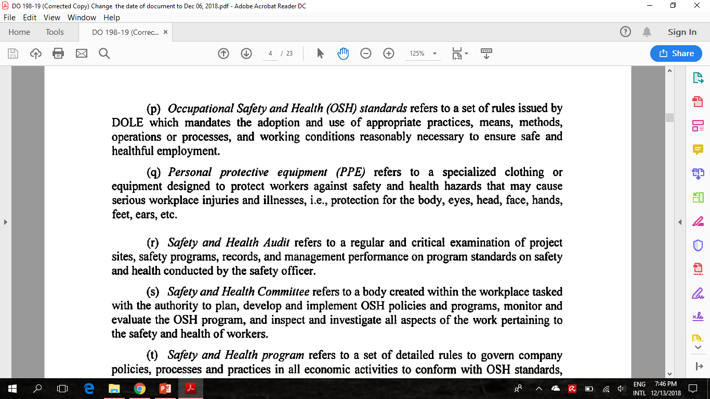
Terms in the IRR:

Slide 22
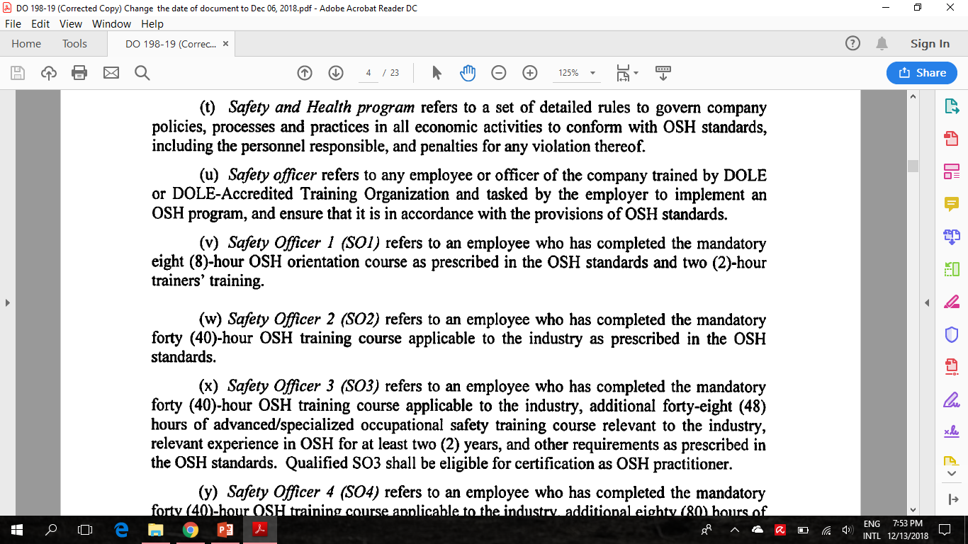
Terms in the IRR:

Slide 23
Terms in the IRR:

Slide 24
CHAPTER III- DUTIES AND RIGHTS OF EMPLOYERS, WORKERS AND OTHER PERSONS
Section 4. Duties of Employers, Workers and Other Persons.
Every employer, contractor or subcontractor, if any, and any person who manages, controls or supervises the work being undertaken shall:
1. Furnish the workers a place of employment free from hazardous conditions

Slide 25
2. Give complete job safety instructions or orientation to all workers
-1st Time
- Familiarization with work environment
3. Inform workers of:
- hazards associated with their work
- health risks involved
- preventive measures to eliminate or minimize risks
- steps to be taken in cases of emergency

Slide 26
4. Use only approved devices/equipment for the workplace
5. Comply with OSH Standards:
- Training - Medical Examination
- Provision of PPE - Machine Guards
6. Allow workers to participate actively in:
- Organizing - Planning
- Implementing - Evaluating OSH programs
7. Provide measures to deal with:
-emergencies - accidents
- first aid arrangements

Slide 27
Every worker shall participate in ensuring compliance with OSH Standards in the workplace.
- proper use of safeguards, safety devices
- observe instructions to prevent accident and imminent danger situations
- observe prescribed steps to be taken in cases of emergency
- report to supervisor any work hazard that may be discovered in the workplace

Slide 28
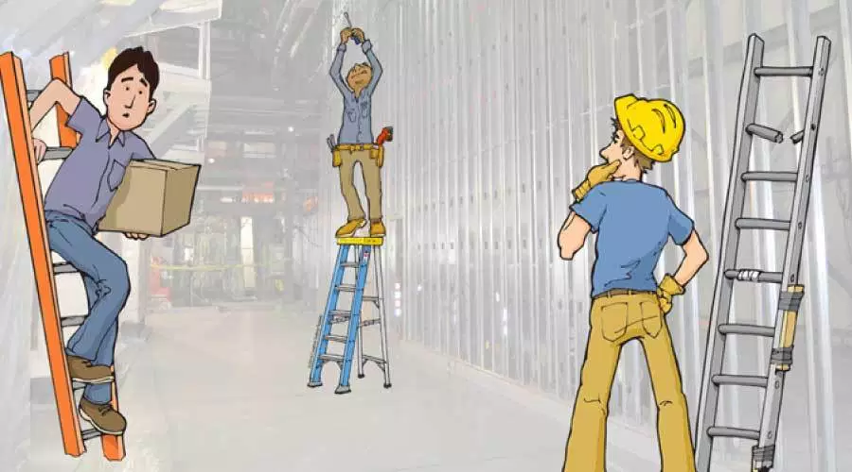
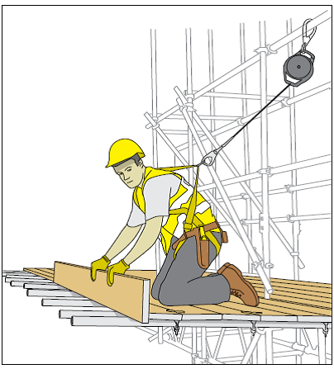
c) It shall be the duty of person, including the builder or contractor who visits, builds, renovates, or installs devices or conducts business in any establishment or workplace to comply with the provisions of this Act and all other regulations issued by the DOLE Secretary.

Slide 29
d) Whenever 2 or more undertakings are engaged in activities simultaneously in 1 workplace, it shall be the duty of all engaged to collaborate in the application of the OSH Standards and regulations

Slide 30
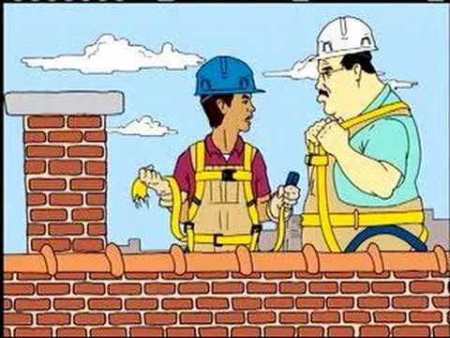
Section 5. Workers’ Right to Know –
All workers shall be appropriately informed by the employer about all types of hazards in the workplace.
Section 6. Workers’ Right to Refuse Unsafe Work –
The worker has the right of refusal to work without threat or reprisal from the employer if, as determined by the DOLE, an imminent danger situation exist.

Slide 31
Section 7. Worker’s Right to Report Accidents –
Workers shall have the right to report:
- accidents
- dangerous occurrences
- hazards
to…
-Employer
-DOLE
-Other concerned government agencies exercising jurisdiction as the competent authority in specific industry

Slide 32
Section 8. Workers’ Right to PPE
-Every employer, contractor or subcontractor if any, shall provide his workers FREE OF CHARGE protective equipment
-The cost of the PPE shall be part of the OSH program which is a separate pay item
-All PPE shall be of the appropriate type as tested and approved by the DOLE evaluated and recommended by the Safety Officer

Slide 33
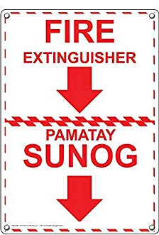
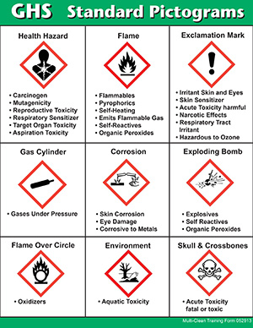
Section 9. Safety Signage and Devices –
Safety signage and devices shall be posted in prominent positions at strategic locations in a language understandable to all, and in accordance with the standards set by the DOLE

Slide 34
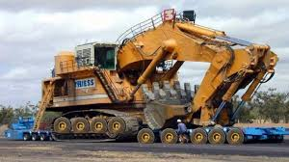
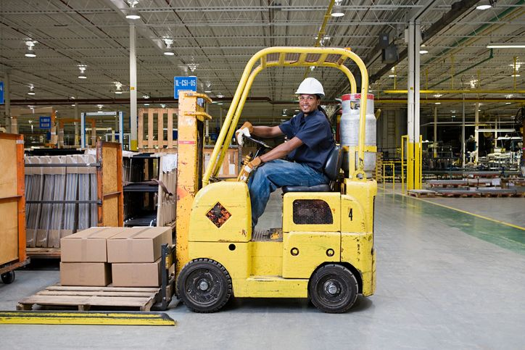
Section 10. Safety in the Use of Equipment –
Employer, Contractor or Subcontractor if any, must comply with DOLE requirements in the different phases of the company or project operation including the transport to and from the establishment or project site

Slide 35
Section 11. Occupational Safety and Health Information
Workers shall be provided adequate and suitable information by the employer, contractor or subcontractor on safety and health hazards, and the appropriate measures, including the probable location of the workers, for the prevention, control and protection against those hazards.

Slide 36
CHAPTER IV – COVERED WORKPLACES
Section 12. OSH Program
Covered workplaces shall have a safety and health program including the following policies, guidelines or information:
Statement of commitment to comply with OSH requirement
General Safety and Health including a Drug Free Workplace, Mental Health, etc.
HIV and AIDS, TB, Hepatitis prevention and control.

Slide 37
d) Company or project details;
e) Composition and duties of the Safety and Health Committee;
f) Occupational Safety and Health personnel and facilities;
g) Safety and health promotion, training and education;
h) Conduct of toolbox meetings;
i) Accident, incident, illness investigation, recording and reporting;
j) Provision and use of PPE;
k) Provision of Safety signage;

Slide 38
l) Dust control and management, and regulations on activities such as building of temporary structures, and lifting and operation of electrical, mechanical, communications system and other equipment;
m) Provision of workers’ welfare facilities;
n) Emergency preparedness and response plan;
o) Waste management system and;
p) Prohibited acts and penalties for violations
-OSH Programs shall be submitted to DOLE

Slide 39
Section 13. Occupational Safety and Health Committee
COMPOSITION:
a) Employer or a representative as the chairperson, ex officio;
b) Safety officer of the company or project as the secretary;
c) Safety officers representing the contractor or the subcontractor, as members;
d) Physicians, nurses, certified first aiders, dentists as members, ex officio, if applicable and ;

Slide 40
e) Workers’ representative who shall come from the union if the workers are organized or elected by the workers through a simple majority vote if they are unorganized, as members
The Committee shall effectively plan, develop, oversee and monitor the implementation of the safety and health program.

Slide 41
Section 14. Safety Officer –
To ensure that a safety and health program is duly followed and enforced, covered workplaces shall have safety officers who shall:
Oversee the overall management of OSH program;
Frequently monitor and inspect any OSH aspect of the operation;
Assist government inspectors at any time during work hours or in accident investigations
Issue work stoppage orders when necessary

Slide 42
From the IRR

Slide 43
From the IRR

Slide 44
In the case of a Contractor or Subcontractor, a safety officer must be deployed at each specific area of operations to oversee the management of the OSH program of its own workforce.

Slide 45
From the IRR

Slide 46
Section 15. Occupational Health Personnel and Facilities
Covered workplaces shall have:
Qualified OH Physicians, Nurses, Certified FA, Dentists
Medical Supplies, Equipment and Facilities

Slide 47
From the IRR

Slide 48
From the IRR

Slide 49
Section 16. Safety and Health Training
All OSH personnel – Mandatory BOSH
All workers- Mandatory 8HRS OSH Seminar
Specialized training for workers in:
Equipment and Scaffolds erection, operation and dismantling, Structural erections, Excavation, Blasting operation, Demolition, Confined spaces
Hazardous chemicals, welding and flame cutting

Slide 50
From the IRR

Slide 51
From the IRR

Slide 52
From the IRR

Slide 53
From the IRR

Slide 54
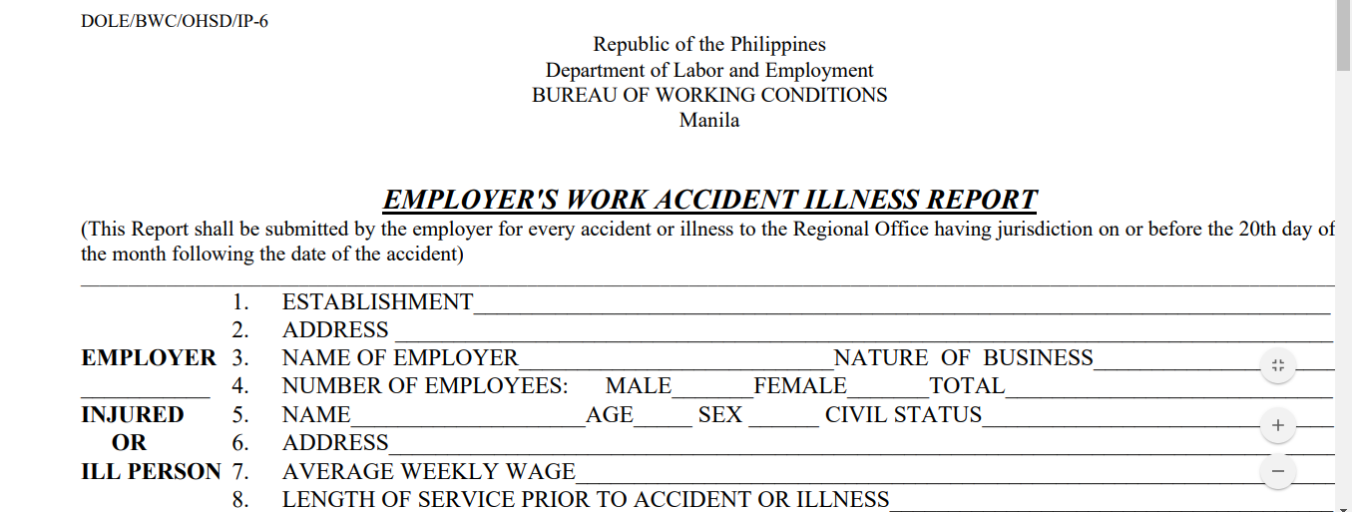
Section 17. OSH Reports
All employers, contractors or subcontractors, shall submit all OSH reports and notifications prescribed by DOLE.

Slide 55
Section 18. Workers’ Competency Certification
TESDA and PRC shall:
-establish national competency standards
-prepare guidelines on competency assessment and certification for critical operations

Slide 56
Critical Operations:
Performance of a job affects peoples’ lives and safety
Job involves handling of tools, equipment and supplies
Job requires long period of education and training
Performance of a job may compromise the safety, health and environmental concerns within the immediate vicinity of the establishment

Slide 57
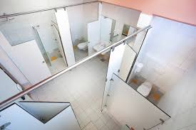
Section 19. Workers’ Welfare Facilities
All places where work is undertaken shall have:
Adequate supply of safe drinking water;
Adequate sanitary and washing facilities;
Suitable living accommodation for workers;
Separate sanitary, washing and sleeping facilities for men and women workers

Slide 58
Section 20. Cost of Safety and Health Programs
-The total cost of implementing a duly approved OSH program shall be an integral part of the operations cost.
-It shall be a separate pay item in construction and in all contracting or subcontracting arrangements.

Slide 59
CHAPTER V: JOINT AND SOLIDARY LIABILITY
Section 21. Employers Responsibility and Liability
The employer, project owner, general contractor or subcontractor, if any, and any person who manages, controls or supervises the work being undertaken shall be jointly and solidarily liable for compliance of this Act.

Slide 60
CHAPTER VI: ENFORCEMENT OF OCCUPATIONAL SAFETY AND HEALTH STANDARDS
Section 22. Visitorial Power of the Secretary of Labor and Employment
-Pursuant to Article 128 of Labor Code
-The Labor Secretary and representatives shall have authority to conduct annual spot audit on OSHS compliance
-Can enter workplaces at any time of day or night where work is being performed

Slide 61
Examine records
Investigate facts, conditions or matters necessary to determine compliance
No person shall obstruct, impede, delay, render ineffective the Orders of the Labor Secretary or duly authorized Rep (LI)
No lower court or entity shall issue TROs/Permanent Injunction/Restraining Orders OR,
Assume jurisdiction over any case involving the enforcement orders

Slide 62
The Labor Secretary may order stoppage of work or suspension of operations of any unit or department of an establishment for non-compliance and imminent danger
The LI as procedure shall present proper IDs and shall only act within the authority and direction given by the Labor Secretary
LI shall inspect establishments and workplaces regardless of the size and nature of operation
Any kind of Self-Assessment shall not take the place of Labor Inspection conducted by DOLE

Slide 63
Chartered cities may be allowed to conduct industrial safety inspection within their jurisdiction with coordination to DOLE and provided they have adequate facilities and competent personnel

Slide 64
Section 23. Payment of Workers During Work Stoppage Due to Imminent Danger
- Employer’s violation or fault
- Employer shall pay the workers concerned their wages during the period of work stoppage/suspension

Slide 65
Section 24. Delegation of Authority
The authority to enforce mandatory OSH standards may be delegated by the Labor Secretary to a competent government authority

Slide 66
Section 25. Standards Setting Power of the Secretary of Labor and Employment
The Labor secretary in consultation with the other concerned government agencies and relevant stakeholders, by appropriate orders set and enforce mandatory OSH standards to eliminate or reduce OSH hazards depending on the number of employees, nature of operations and risk/hazards involved

Slide 67
The Secretary shall also institute new and update existing programs to ensure safe and healthy working conditions in all workplaces especially in hazardous industries…
-Mining
- Fishing
- Construction
- Maritime

Slide 68
Section 26. Employee’s Compensation Claim
- Worker may file claims for compensation benefit arising out of the work-related disability or death
- Claims shall be processed independently of the finding of fault, gross negligence or bad faith of the employer

Slide 69
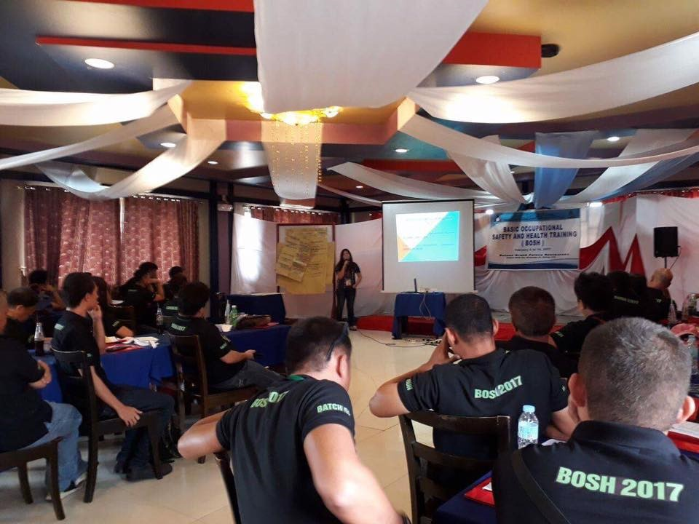
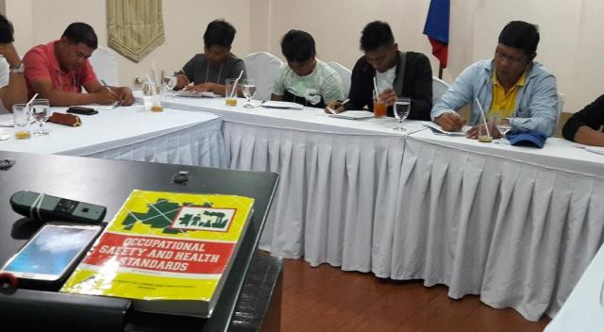
Section 27. Incentives to Employers
Established package of Incentives:
- OSH Training
- Additional PPE
- Technical Guidance
- Recognition Awards
- Others

Slide 70
Section 28. Prohibited Acts
The following are considered prohibited acts:
Willful failure or refusal of an employer, contractor or subcontractor to comply with the OSH standards or compliance order from DOLE
LIABILITY: Admin fine not exceeding Php100,000.xx per day until the violation is corrected

Slide 71
Matrix of Administrative Fines:

Slide 72
b) Willfully fails or refuses to comply with the required OSH standards or with a duly issued compliance order, and engages in any of the following acts to aid, conceal or facilitate such non-compliance
LIABILITY: Admin fine separate from the daily fine of a Maximum of Php100,000.xx
These are:

Slide 73
Repeated obstruction, delay or refusal to provide LI access to workplace or refusal to provide/allow access to relevant records and documents or obstruct the conduct of investigation of any fact in determining compliance to OSH Standards
Misrepresentation in relation to adherence to OSH Standards, knowing such statement, report or record submitted to the DOLE to be false in any material aspect
Making retaliatory measures such as termination of employment, refusal to pay, reducing wages and benefits or in any manner discriminates against any worker who has given information relative to the inspection being conducted

Slide 74
The DOLE shall issue a list of offenses with corresponding reasonable administrative fines depending on the severity, frequency and damage caused without prejudice to the filing of criminal or a civil case in the regular courts , as the case may be.
The fine collected shall be used for the operations of OSH initiatives, including OSH training and education, and other OSH Programs

Slide 75
CHAPTER VII: MISCELLANEOUS PROVISIONS
Section 29. Updated DOLE Computerized Labor Law Compliance System
- Updated Labor Inspections System of computerized gathering and generation of real time data on compliances, monitoring of enforcement
- System of Notification on workplace accidents and injuries

Slide 76
Section 30. Applicability to Small and Micro Enterprises (MSEs)
All MSEs shall implement prescribed standards on:
- Housekeeping
- Materials Handling and Storage
- Electrical, Mechanical and Chemical safety
- Emergency Preparedness, Fire Safety
- PPE
- Regular HAZARD monitoring

Slide 77
Section 31. Inter-Governmental Coordination and Cooperation
DOLE shall institute a mechanism for coordination with:
DENR - DOE - LGU
DOT - DA
DPWH - DTI
DILG - DOH
DICT - PEZA
Other Gov’t Agencies
Within 60 Days from the issuance of the IRR of this Act

Slide 78
Section 32. Implementing Rules and Regulations
DOLE with Agencies concerned shall formulate the rules and regulations within 90 Days after the effectivity of this Act.

Slide 79
Section 33. Separability Clause
If any part, section or provision of this Act shall be held invalid or unconstitutional, the other provisions not affected by such declaration shall remain in full force and effect.

Slide 80
Section 34. Repealing Clause
All laws, acts, decrees, executive orders, rules and regulations or other issuances or parts thereof which are inconsistent with these Act are hereby modified or repealed.

Slide 82
END

