Slide 1
DEPARTMENT ORDER NO. 182
Series of 2017
By: MA. TERESA D. TANQUIAMCO
Supervising LEO , DOLE RO 7 - TSSD-LRS
GUIDELINES GOVERNING THE EMPLOYMENT
AND WORKING CONDITIONS OF HEALTH PERSONNEL IN THE PRIVATE HEALTHCARE INDUSTRY

Slide 2
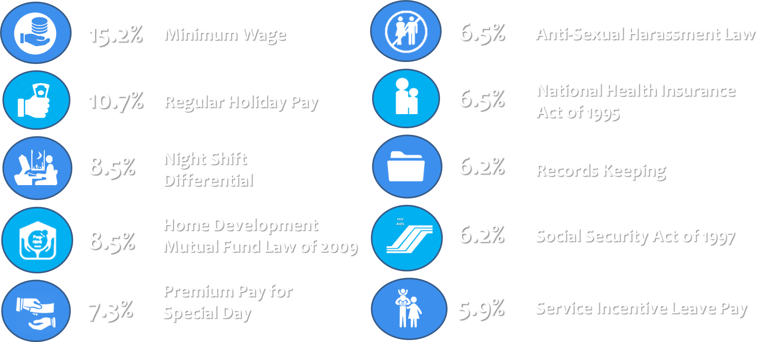
COMMON GLS DEFICIENCIES
Notes:
Pursuant to the rule-making power of the Secretary of Labor and Employment under Article 5 of the Labor Code of the Philippines, as renumbered

Slide 3
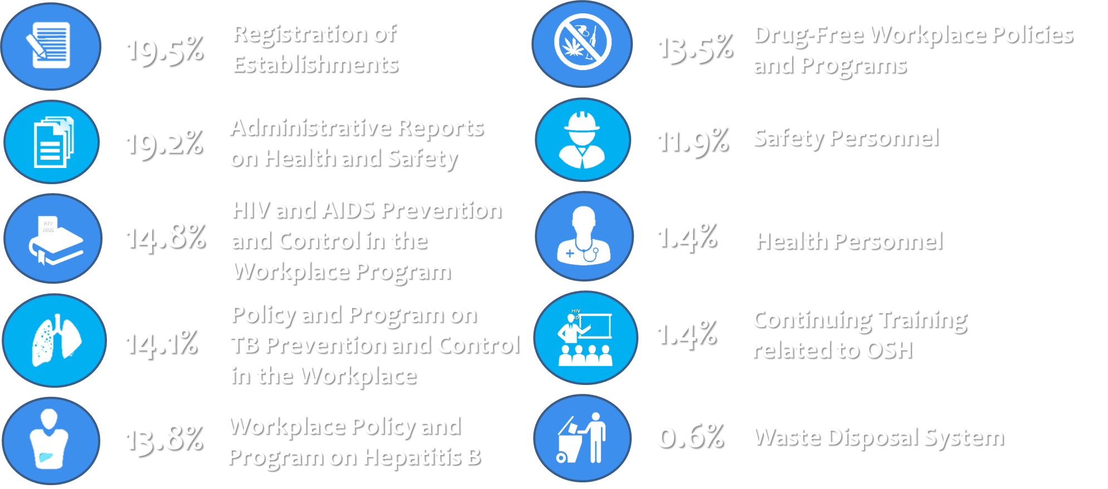
COMMON OSHS DEFICIENCIES
Notes:
Pursuant to the rule-making power of the Secretary of Labor and Employment under Article 5 of the Labor Code of the Philippines, as renumbered

Slide 4
OBJECTIVES
The following guidelines are hereby issued for compliance of all concerned to ensure the protection and welfare of health personnel employed in the private healthcare industry.
Notes:
Pursuant to the rule-making power of the Secretary of Labor and Employment under Article 5 of the Labor Code of the Philippines, as renumbered

Slide 5
COVERAGE
This Guidelines shall apply to health personnel and establishments, workplaces, operations and undertakings in the private healthcare industry.
Notes:
Pursuant to the rule-making power of the Secretary of Labor and Employment under Article 5 of the Labor Code of the Philippines, as renumbered

Slide 6
COVERAGE
other workers in the private health care industry who are exposed to airborne contaminants, human carcinogens, substances, or chemicals that exceed threshold limit values or tolerance levels for an eight-hour workday as prescribed under the OSHS and other relevant regulations.
Notes:
Pursuant to the rule-making power of the Secretary of Labor and Employment under Article 5 of the Labor Code of the Philippines, as renumbered

Slide 7
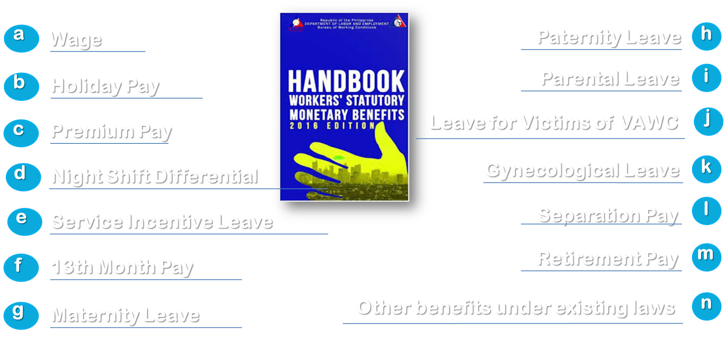
MINIMUM BENEFITS
Notes:
Wages shall be paid at least once every two weeks or twice a month at intervals not exceeding sixteen (16) days.

Slide 8
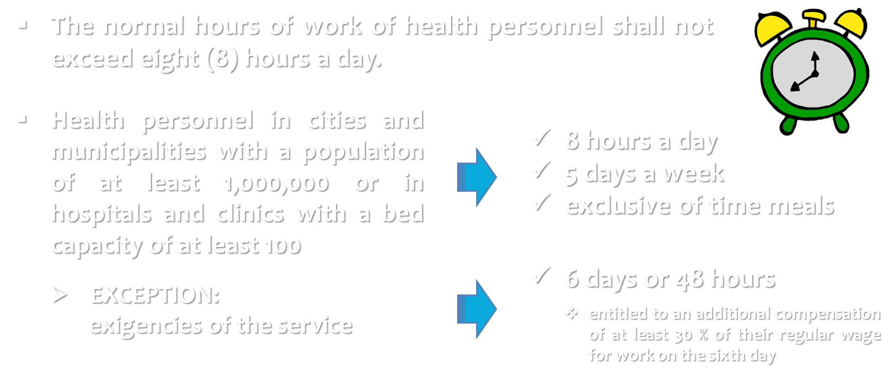
HOURS OF WORK
Notes:
Pursuant to the rule-making power of the Secretary of Labor and Employment under Article 5 of the Labor Code of the Philippines, as renumbered

Slide 9
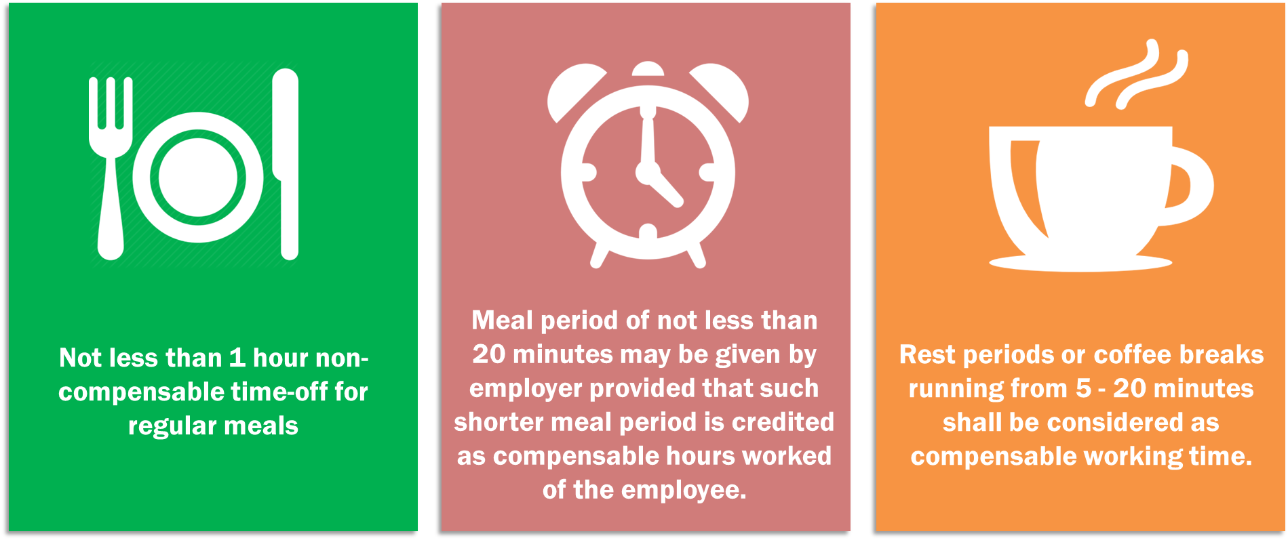
MEAL AND REST PERIODS
Notes:
Pursuant to the rule-making power of the Secretary of Labor and Employment under Article 5 of the Labor Code of the Philippines, as renumbered

Slide 10
NIGHT WORK SCHEDULES
The employer shall, at his own initiative, consult the recognized workers’ representatives or union in the establishment on the details of the night work schedules.
In establishments employing night workers, consultation shall take place regularly and appropriate changes of work schedule shall be agreed upon before it is implemented taking into consideration the provisions of Republic Act No. 10151 and its Implementing Rules and Regulations.
Notes:
Pursuant to the rule-making power of the Secretary of Labor and Employment under Article 5 of the Labor Code of the Philippines, as renumbered

Slide 11
WAITING TIME
Waiting time such as endorsement period, spent by health personnel shall be considered as working time if he or she is required or engaged by the employer to wait.
A health personnel who is required to remain on call in the employer’s premises or so close thereto that he cannot use the time effectively and gainfully for his own purpose shall be considered as working while on call.
An employee who is not required to leave word at his home or with company officials where he may be reached is not working while on call.
Notes:
Pursuant to the rule-making power of the Secretary of Labor and Employment under Article 5 of the Labor Code of the Philippines, as renumbered

Slide 12
COMPRESSED WORK WEEK SCHEME
Compressed work-week schemes shall not be utilized in health services or in occupations or workplaces in which employees are exposed to airborne contaminants, human carcinogens, substances, chemicals or noise that exceed threshold limit values or tolerance levels for an eight-hour workday as prescribed under the Occupational Safety and Health Standards (OSHS) pursuant to DOLE Department Advisory No.02, Series of 2004.
Notes:
Pursuant to the rule-making power of the Secretary of Labor and Employment under Article 5 of the Labor Code of the Philippines, as renumbered

Slide 13
OCCUPATIONAL SAFETY AND HEALTH
The employer shall adopt, implement and promote occupational safety and health programs consistent with the provisions of the OSHS and other related laws and issuances, to include prevention and control of Tuberculosis, HIV AIDS, Hepatitis B, workplace bullying and drug use in the workplace.
The employer shall promote and implement policies and programs on anti-smoking, anti-sexual harassment and disaster and climate risk management.
The employer shall organize a safety and health committee in accordance with the OSHS.
Notes:
Pursuant to the rule-making power of the Secretary of Labor and Employment under Article 5 of the Labor Code of the Philippines, as renumbered

Slide 14
PROVISION OF PPEs
All healthcare institutions are required to provide their employees the appropriate personal protective equipment at no cost to employees, student-trainees or interns, and apprentices pursuant to the OSHS and other related laws and issuances.
Notes:
Pursuant to the rule-making power of the Secretary of Labor and Employment under Article 5 of the Labor Code of the Philippines, as renumbered

Slide 15
HEALTH PERSONNEL REQUIREMENT
Every healthcare facility shall have an adequate number of qualified, trained and competent staff to ensure efficient and effective delivery of quality services as prescribed by Department of Health (DOH).
Notes:
Pursuant to the rule-making power of the Secretary of Labor and Employment under Article 5 of the Labor Code of the Philippines, as renumbered

Slide 16
RIGHT TO SECURITY OF TENURE
Health personnel shall enjoy security of tenure in their employment as provided by law.
Their services can only be terminated for just or authorized causes pursuant to the provisions of the Labor Code, as renumbered, and subject to the requirements of due process.
Notes:
Pursuant to the rule-making power of the Secretary of Labor and Employment under Article 5 of the Labor Code of the Philippines, as renumbered

Slide 17
A FULL-TIME NURSE MAY NOT BE CONSIDERED A REGULAR EMPLOYEE
“The phrase "services of a full-time registered nurse" should thus be taken to refer to the kind of services that the nurse will render in the company’s premises and to its employees, not the manner of his engagement.”
G.R. No. 178827, March 4, 2009

Slide 18
RIGHT TO SELF ORGANIZATION & CBA
Health personnel shall have the right to form, join or assist in the formation of a labor organization of their own choosing for purposes of collective bargaining and to engage in concerted activities which are not contrary to law.
Notes:
Pursuant to the rule-making power of the Secretary of Labor and Employment under Article 5 of the Labor Code of the Philippines, as renumbered

Slide 19
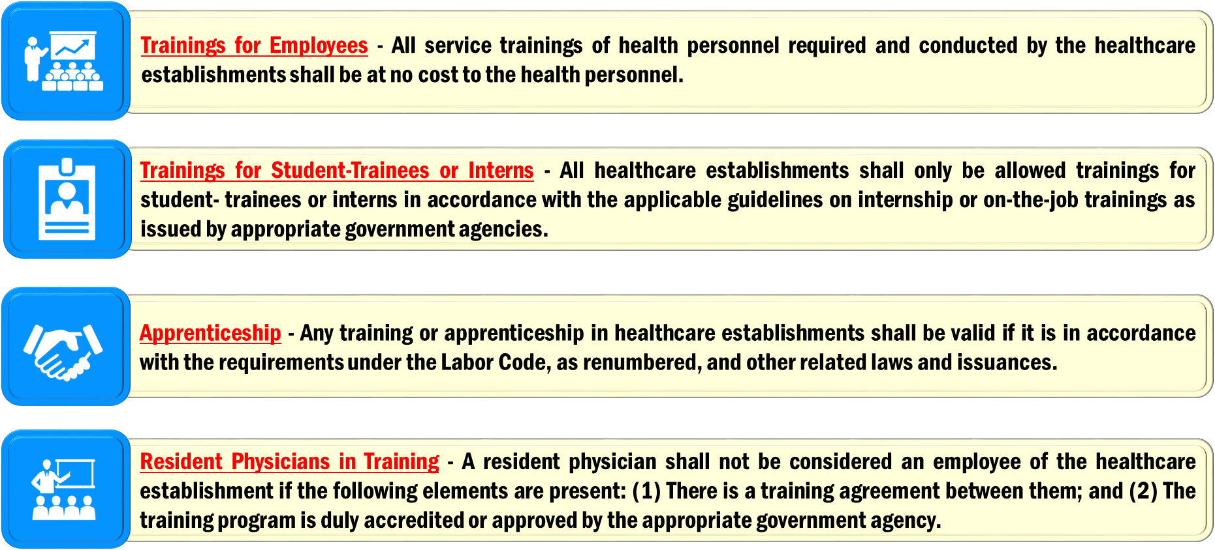
ALLOWABLE TRAININGS
Notes:
Pursuant to the rule-making power of the Secretary of Labor and Employment under Article 5 of the Labor Code of the Philippines, as renumbered

Slide 20
VOLUNTEER PROGRAMS
All health related volunteer programs shall only be undertaken by Department of Health (DOH) accredited non-profit hospitals or government hospitals in accordance with the provisions of Republic Act No. 9418 and its implementing rules and regulations.
Volunteer programs carried-out by profit-oriented hospitals or health care institutions shall be subject to the requirements of the Labor Code, based on employer-employee relationship between the so-called volunteer and the healthcare institution.
The practice of profit-oriented healthcare establishments in accepting volunteers is prohibited.
Notes:
Pursuant to the rule-making power of the Secretary of Labor and Employment under Article 5 of the Labor Code of the Philippines, as renumbered

Slide 21
COMPLIANCE AND ENFORCEMENT
Compliance with labor standards shall be enforced by the DOLE Regional Office which has jurisdiction over the workplace in accordance with the provisions of Article 128 of the Labor Code, as renumbered, and it’s implementing rules and regulations.
Notes:
Pursuant to the rule-making power of the Secretary of Labor and Employment under Article 5 of the Labor Code of the Philippines, as renumbered

Slide 22
CON/MED THRU SEnA
All issues on employment involving health personnel, such as disciplinary measures, suspension and termination, shall be subject to the 30- day mandatory conciliation-mediation or the Single Entry Approach (SEnA) of the DOLE pursuant to Department Order No. 15 1-16 or the implementing Rules and Regulations of Republic Act No. 10396.
Notes:
Pursuant to the rule-making power of the Secretary of Labor and Employment under Article 5 of the Labor Code of the Philippines, as renumbered

Slide 23
REPEALING CLAUSE
All policies, issuances, rules and regulations and agreements inconsistent with this Guidelines, are hereby repealed or modified accordingly.
Notes:
Pursuant to the rule-making power of the Secretary of Labor and Employment under Article 5 of the Labor Code of the Philippines, as renumbered

Slide 24
EFFECTIVITY
This Order shall take effect fifteen (15) days after its publication in a newspaper of general circulation.
Manila, Philippines, September 22, 2017.
Notes:
Pursuant to the rule-making power of the Secretary of Labor and Employment under Article 5 of the Labor Code of the Philippines, as renumbered

